Slide 1
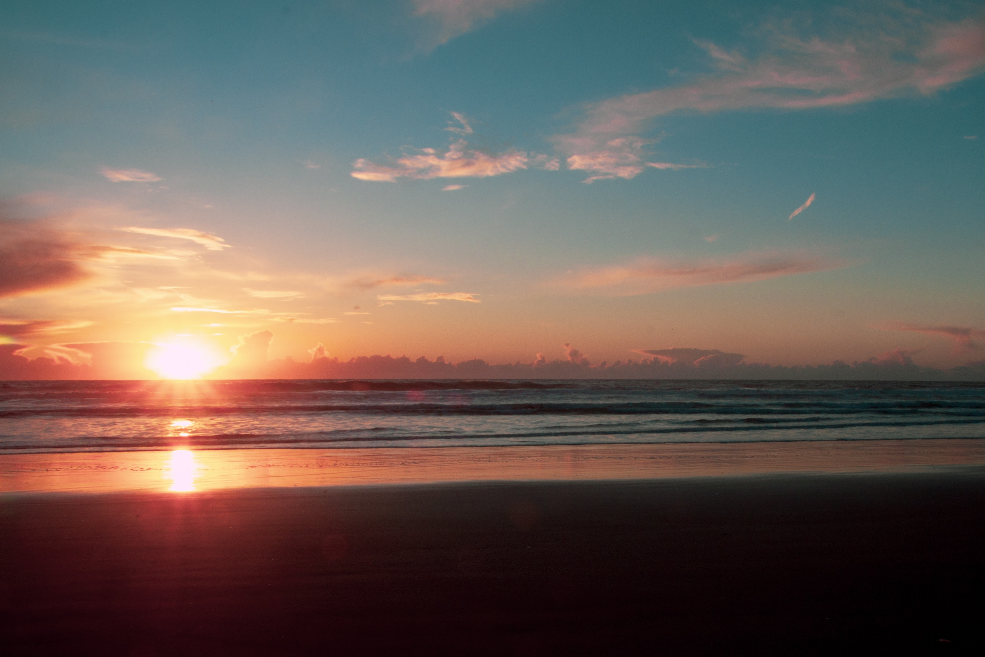
Presenting
four seasons
of
Kashmir

Slide 2
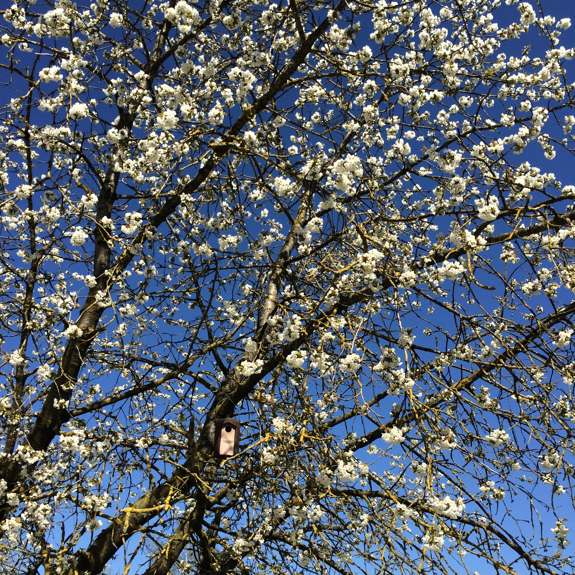
SPRING
The spring season is a time of year when the weather starts to change. It is a transition season between the winter and summer season

Slide 3
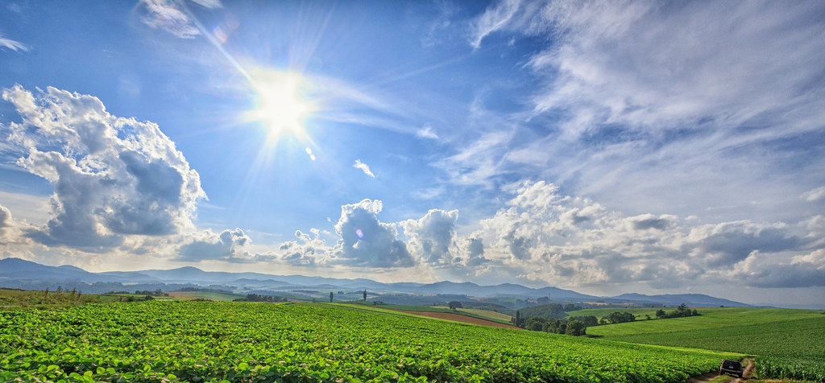
summer
Summer or summertime is the hottest and brightest of the four temperate seasons, occurring after spring and before autumn

Slide 4
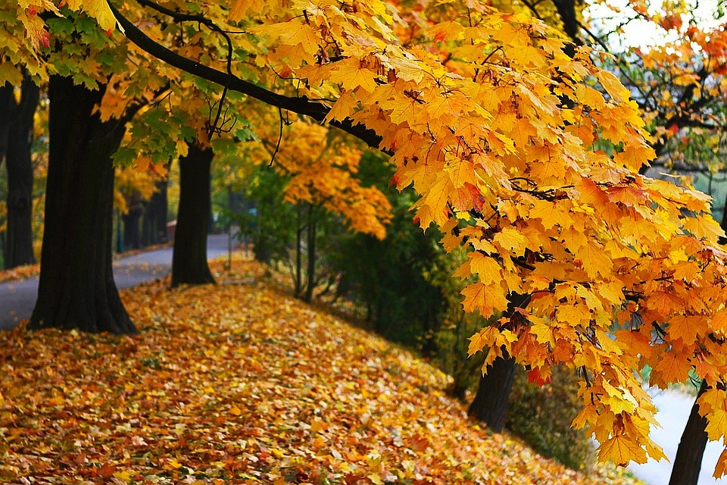
Autumn
The autumn months are the time of the harvest season. Autumn is generally regarded as the end of the growing season.

Slide 5
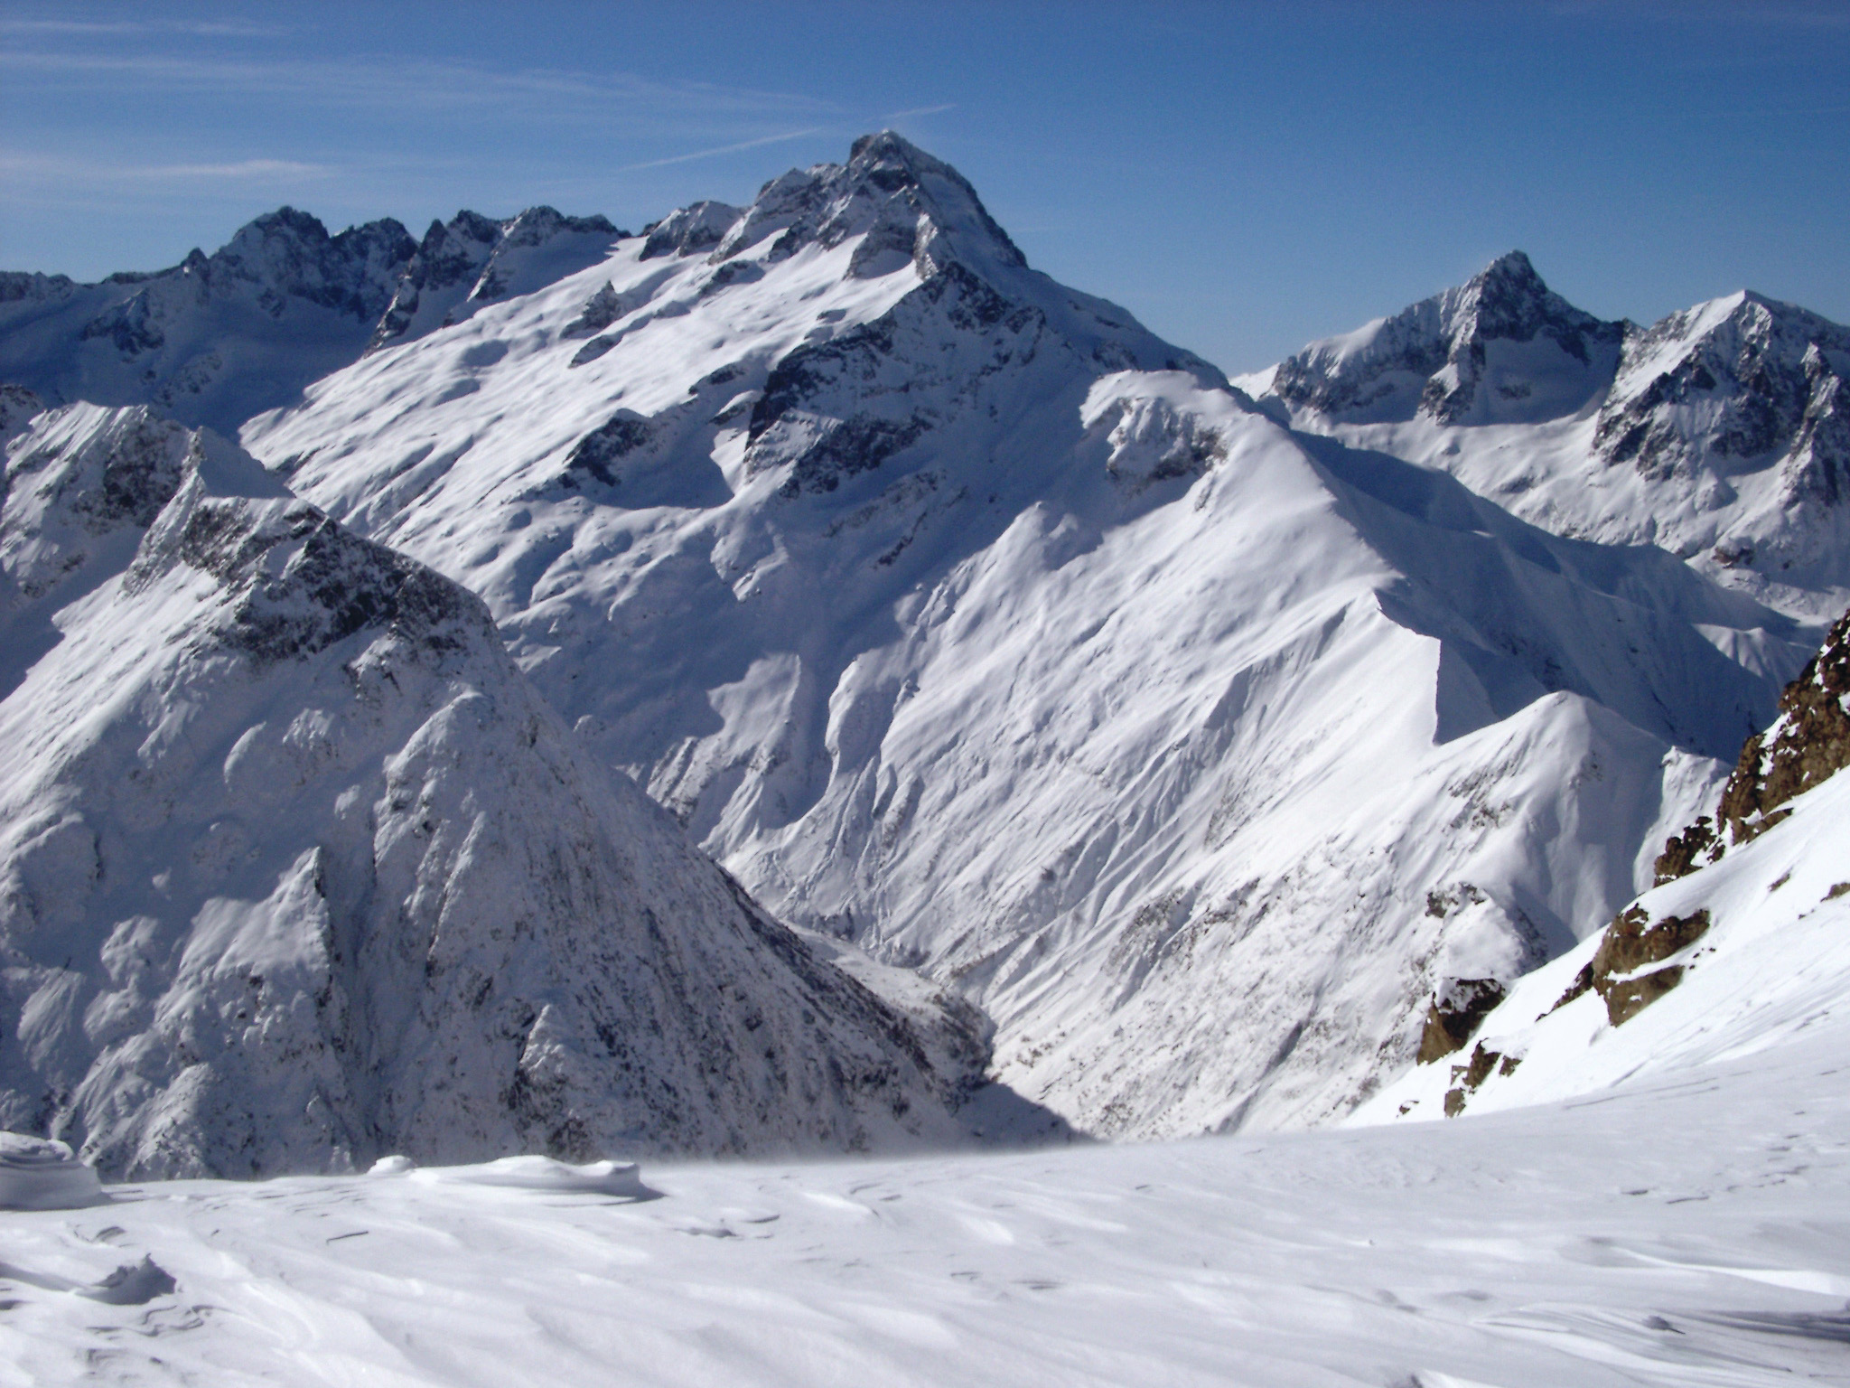
winter
winter is the coldest time of year because it is when the Northern Hemisphere points away from the sun.

